Slide 1

Logistic Regression

Slide 2
Introduction
Logistic regression is a supervised machine learning algorithm
It is a type of classification algorithm
predict the probability that an instance belongs to a given class or not
analyze the relationship between a set of independent variables and the dependent binary variables

Slide 3
Example:
Predicting whether a patient has diabetes or not
Classifying emails as either spam or not spam
Predicting whether a website visitor will make a purchase or not
Classifying social media comments or posts as positive, negative, or neutral sentiment

Slide 4
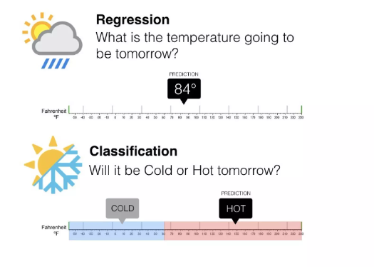

Slide 5
It’s referred to as regression because it is the extension of linear regression
linear regression output is the continuous value while logistic regression predicts the probability
It can be either Yes or No, 0 or 1, true or False
In Logistic regression, instead of fitting a regression line, we fit an “S” shaped logistic function, which predicts two maximum values (0 or 1)

Slide 6
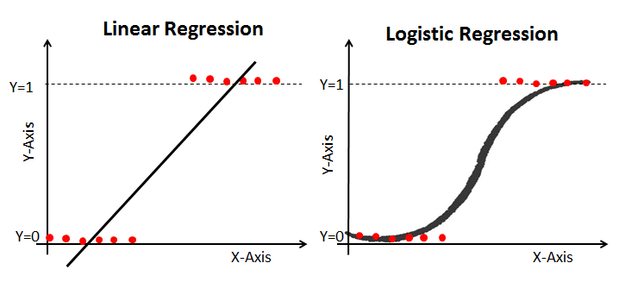

Slide 7
Types of Logistic Regression
Binary Logistic Regression
the dependent variable (target) has two categories or classes
spam detection (spam or not spam) or disease diagnosis (disease or no disease)
Multinomial Logistic Regression
the dependent variable can have more than two categories or classes
the use of Chest X-ray images as features that give indication about one of the three possible outcomes (No disease, Viral Pneumonia, COVID-19)

Slide 8
Ordinal Logistic Regression
It is used in cases when the target variable is of ordinal nature
the target variable has more than two categories
the grades obtained on an exam have categories that have quantitative significance and they are ordered as (A, B, C, D)

Slide 9

Logit Function (Sigmoid Function)
Logistic Regression predicts the probability of occurrence of a binary event utilizing a logit function
Linear Regression Equation:
Sigmoid Function:

Slide 10

Apply Sigmoid function on linear regression:

Slide 11
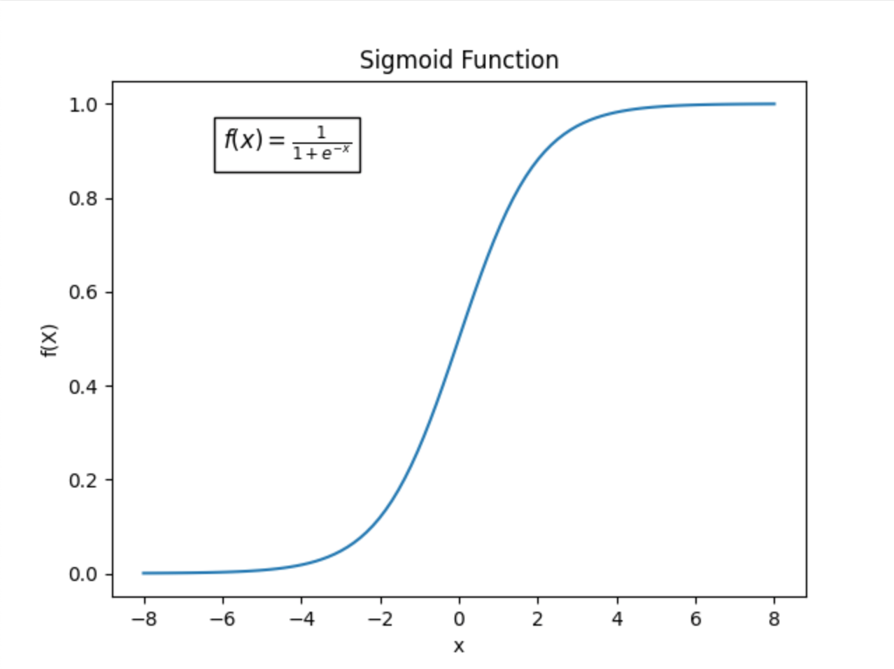
Graph of sigmoid function

Slide 12
Decision Boundary
To predict which class a data belongs, a threshold can be set
Based upon this threshold, the obtained estimated probability is classified into classes
If predicted value ≥ 0.5, then classify email as spam else as not spam
Decision boundary can be linear or non-linear. Polynomial order can be increased to get complex decision boundary

Slide 13
Fitting the best curve
We use Maximum Likelihood Method and Gradient Descent algorithm to optimize the model

Slide 14
Maximum Likelihood Method (MLM)
MLM is used to estimate the parameters (coefficients and intercept) of the logistic regression model
The goal of MLM is to find the parameter values that maximize the likelihood of observing the given data under different values of the model's parameters
It involves finding the best-fitting parameters that make the model's predictions match the observed binary outcomes as closely as possible.

Slide 15
Gradient Descent
Gradients descent is an optimization algorithm get helps you update the parameters iteratively to find the parameters which gives highest probability of y
https://datascience.stackexchange.com/questions/106888/mle-gradient-descent-in-logistic-regression

Slide 16
Cost function
The cost function, such as the logistic loss (for binary logistic regression) or cross-entropy loss (for multiclass logistic regression), is a mathematical function used during the training phase of a machine learning model.
Its primary purpose is to quantify the difference between the model's predictions and the actual target values (binary or multiclass outcomes).
The goal during training is to minimize this cost function by adjusting the model's parameters (coefficients and intercept)
The cost function measures how well the model fits the training data and penalizes prediction errors, guiding the model toward better parameter values.

Slide 17
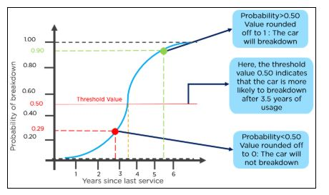

Slide 18
Evaluation metrics of logistic regression
Accuracy
Confusion Matrix
Precision
Recall
F1-Score
ROC Curve

Slide 19
Confusion Matrix
matrix that summarizes the performance of a machine learning model on a set of test data
It is a means of displaying number of accurate and inaccurate instances from the model’s predictions

Slide 20
It displays the following value:
true positives (TP):
occurs when the model accurately predicts a positive data point.
true negatives (TN):
occurs when the model accurately predicts a negative data point.
false positives (FP):
occurs when the model predicts a positive data point incorrectly.
false negatives (FN):
occurs when the model predicts a negative data point incorrectly.

Slide 21
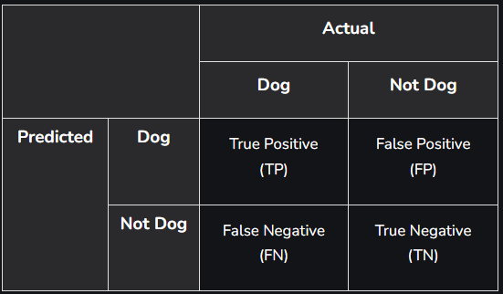
2X2 Confusion matrix (dog or not)

Slide 22
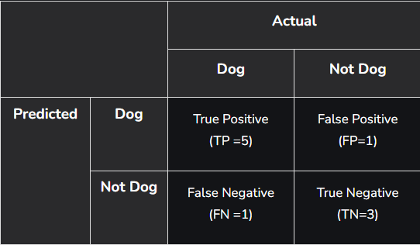

Slide 23

Accuracy
Accuracy is used to measure the performance of the model.
It is the ratio of Total correct instances to the total instances.

Slide 24

Precision
Precision is a measure of how accurate a model’s positive predictions are
It is defined as the ratio of true positive predictions to the total number of positive predictions made by the model.

Slide 25

Recall
Recall measures the effectiveness of a classification model in identifying all relevant instances from a dataset.
It is the ratio of the number of true positive (TP) instances to the sum of true positive and false negative (FN) instances.

Slide 26

F1-Score
F1-score is used to evaluate the overall performance of a classification model.
It is the harmonic mean of precision and recall.

Slide 27
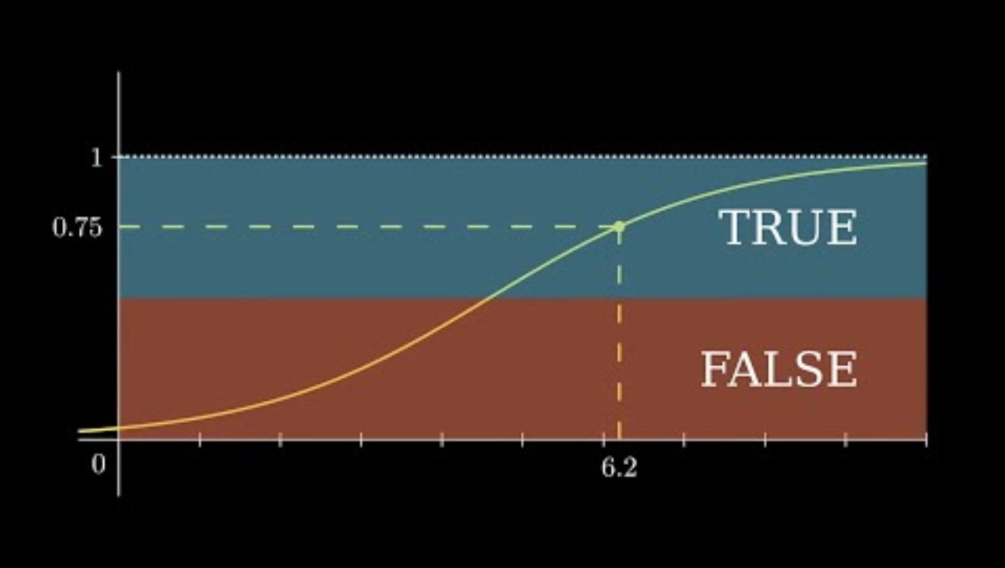
Video summary

Slide 28
Thank You

